Slide 1


Transforming Agriculture in a
Digital Economy Using Artificial
Intelligence
Dr. Kadeghe G Fue (visit www.kadefue.com)
Electronics and Precision Ag Lab (EPAL)
Sokoine University of Agriculture
EMAI Conference 2022
14th-16th November 2022 | CO-ICT, DLab - Dar es Salaam, Tanzania

Slide 2
Digital economy
Five-Year Development Plan III presented last year at the parliament
The Third and final Five-Year National Development Plan 2021/22 - 2025/26 Theme:
  Realizing competitiveness and
  Industrialization for human development
Aims to increase
  efficiency and
  productivity in manufacturing
  using the resources available in abundance within the country.
We have brains. Don’t we?

Slide 3
Digital economy (FYDP III)
Digital economy or Internet Economy, the New Economy, or Web Economy is an economy based on digital computing technologies.
Application of Digital tech and Data Analysis in:
  Precision agriculture,
  integrated supply chain,
  just-in-time production,
  access to finance
New terms in TZ FYDP III:
  Innovation like robotics, artificial intelligence (AI), the “internet of things” (IoT), industrial biotechnology, nanotechnology and advanced materials, cloud computing, block chain, energy storage, 3D printing, Big Data, etc.

Slide 4
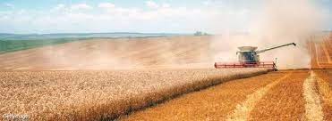
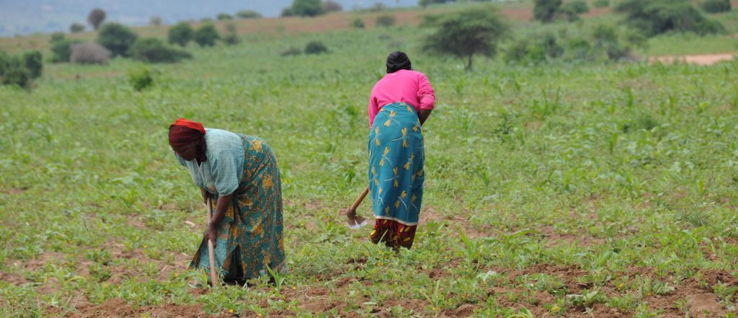
Farming in the US vs Africa
Do we really need to adopt every tech from the developed world?
2 Mil Farms -> about 435 acres
33 Mil smallholder farms -> less than 3 acres
USA
Africa
Mechanization Vs Robotics?
Credit: MARTIN BOND/SCIENCE PHOTO LIBRARY
Credit: SABC News
1.3% Farmers
61%Farmers

Slide 5
Where is the problem?
No connection between Ag specialists/Farmers, Sensor Developers and AI Scientists (Working in isolation)
Ag specialists/farmers generate Data
Data Scientist/AI Specialists need Data
(Hardware issue?) No progress in low cost sensor development to help generate Data in Africa
  Weather sensors, Soil sensors, Spectral technology imaging, thermal imaging, Fluorescence-Transmittance Imaging

Slide 6
What are the Opportunities for AI research
Available free satellite imagery (sentinel, Landsat, MODIS etc.)
  Improve irrigation Scheduling
  Improve fertilization, Subsidized fertilizer distribution, crop yield predictions
  Monitor emergence of diseases and pests
  Solve farmer-pastoralists conflicts
  Promote Digital Land Reforms and Farm Boundaries (credited for tiger economies)
  NLP for Farmers
  Improve Weather prediction to farm-level and more using GANs
  Improve credit worthiness and Crop Insurance Premiums (prices?)
Available genetic data and phenotypic data from crop breeders [Crop Phenomics] (Fasten Seed Development)

Slide 7
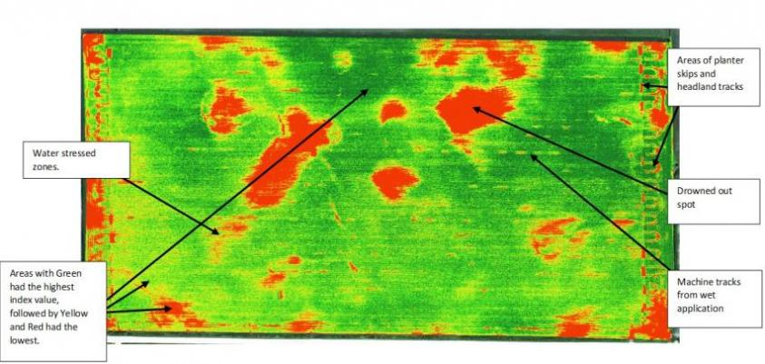
Site Specific Problems on Farms
Credit: Iowa State University

Slide 8



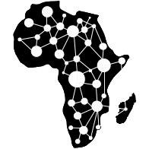





OUR EPA Lab’S WORK
We are working in developing several technologies:
  Precision irrigation Controllers, Agro-advisory systems etc.,
  YEESI Lab for Machine Vision Social Innovations
  Precision irrigation Scheduling
  Precision fertilization using remote sensing
  Low-cost Multipurpose high-throughput Phenotyping
  Digital Evaluation and monitoring
  Farm Performance and Early Warning Systems
  Farm risk estimation for insurance

Slide 9
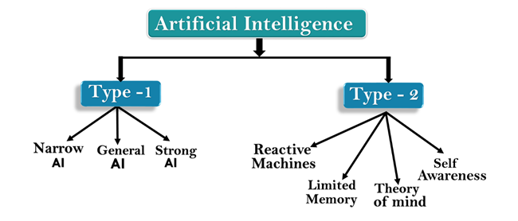
Limited Memory AI for Agriculture
Farming needs Historical Information because Biosystems tend to change rapidly BUT maintain patterns

Slide 10
How to monitor Country-wide Crop Performance?
Data can be retrieved from Climate Data Store like https://cds.climate.copernicus.eu/#!/home
Yield Data can be retrieved from MoA
Imagery data can be downloaded from free satellites like Sentinel, Landsat and MODIS
Daily weather information from Weather forecasting sites and USGS/NOAA

Slide 11
Crop Monitoring For Food Security
WRSI: It is a ratio of actual to potential evapotranspiration. These ratios are crop specific, and are based upon crop development and known relationships between yields and drought stress.
  http://41.73.194.138/tsecgis/food_security_monitor.html
Machine Learning: It is based on historical dataset available

Slide 12
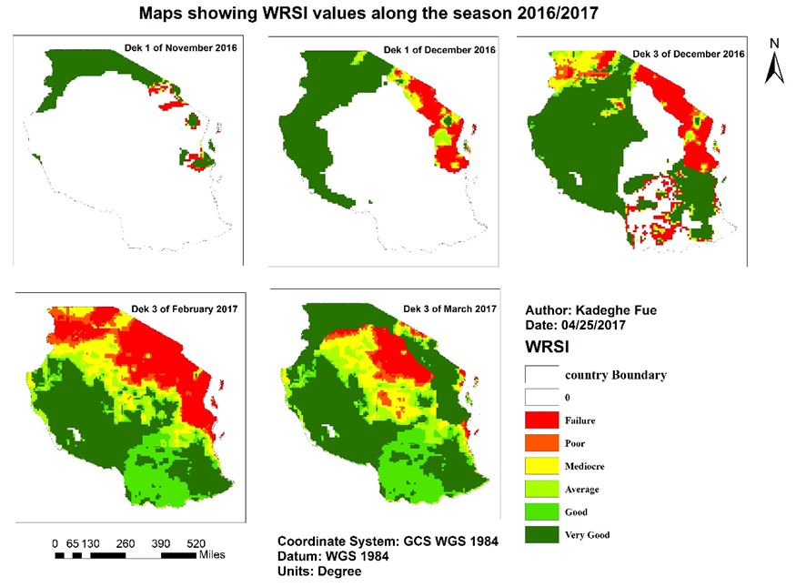
WRSI

Slide 13
Credit and Insurance
Several financial institutions now in Tanzania offer credits and insurances to farmers especially small holder farmers
Small-holder farmers are not TRUSTED by these institutions. They are forced to form groups.
Painful High premiums and interest rates
Can’t we locate the best farmers and award them best rates using Data Driven techniques like AI?
Some sort of Credit Score based on Historical Information that everybody can trust.
Let us Discuss

Slide 14
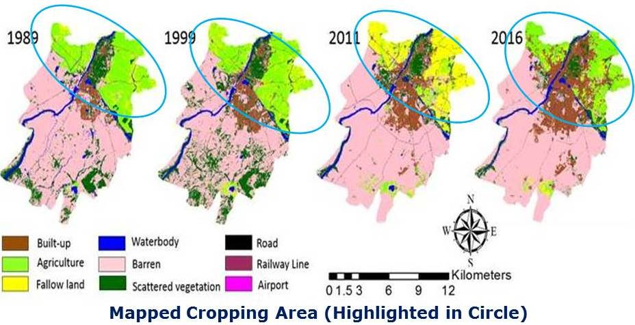
Monitoring Cropping Area (25 years change)
Courtesy: Geo-Spatial Technology for Agriculture Studies

Slide 15
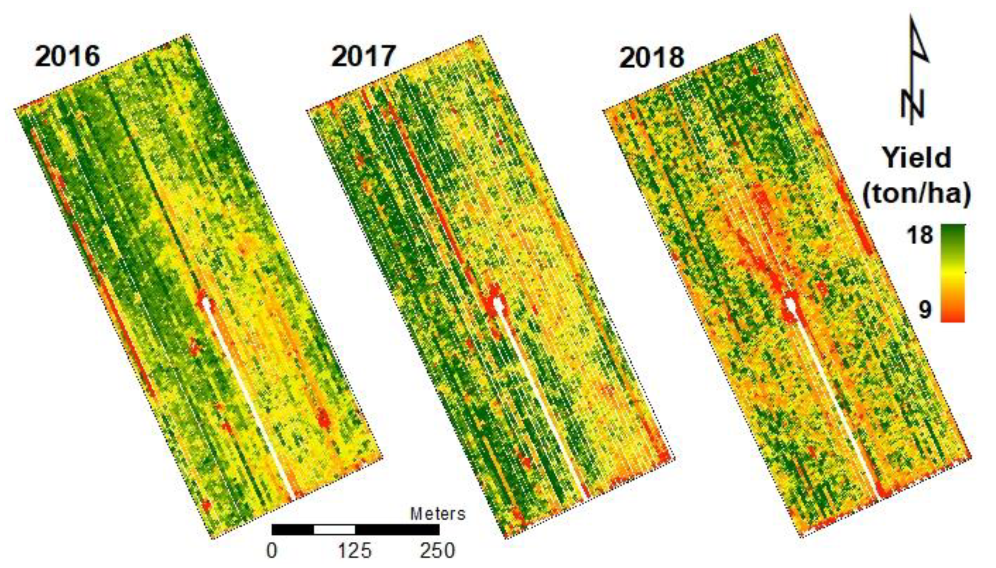
Monitoring Within-Field Variability of Crop Yield using Satellite and Machine Learning Techniques
Kayad, A., Sozzi, M., Gatto, S., Marinello, F., & Pirotti, F. (2019). Monitoring within-field variability of corn yield using Sentinel-2 and machine learning techniques. Remote Sensing, 11(23), 2873.

Slide 16
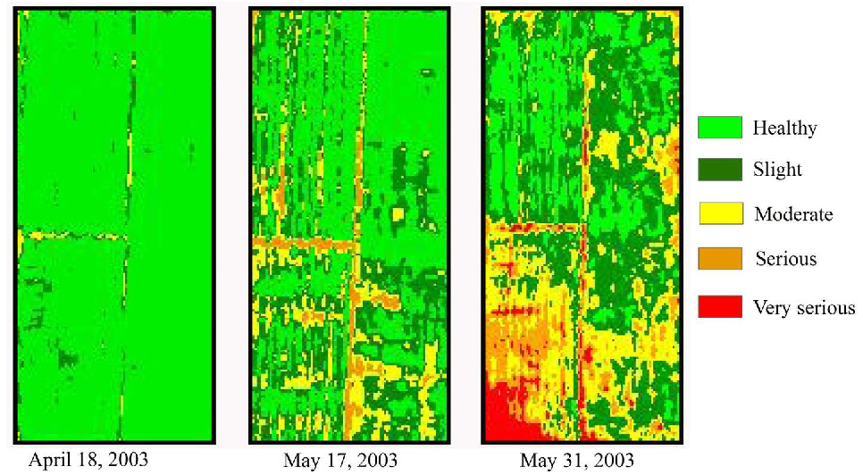
Disease/Pest Infestation Estimations

Slide 17
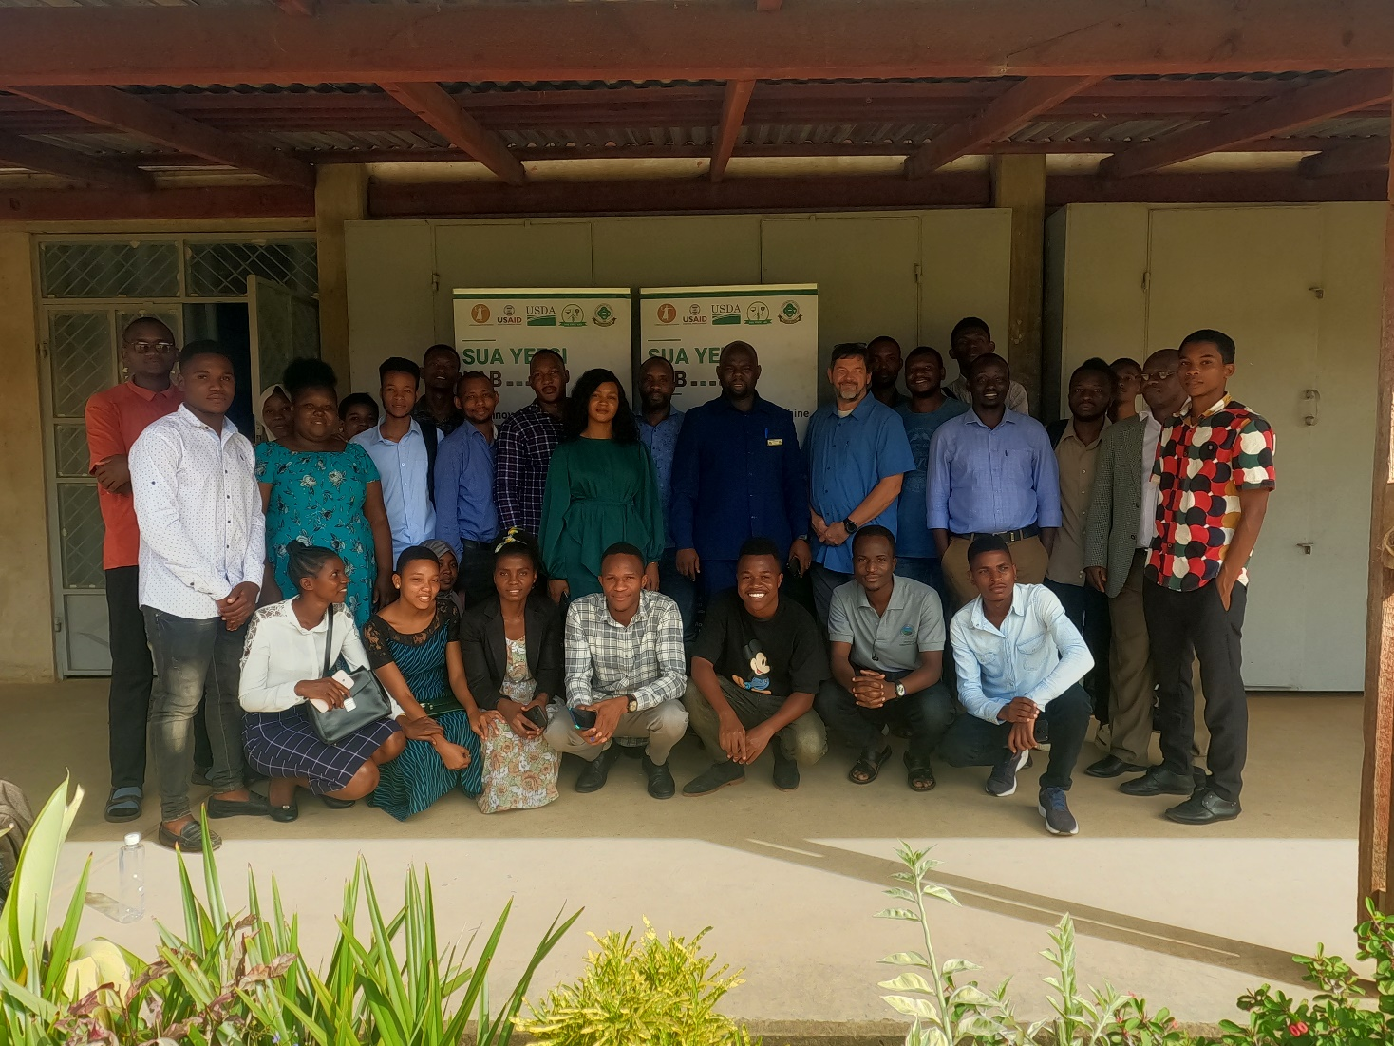
Thank You Very Much www.kadefue.com www.yeesi.org

