Slide 1
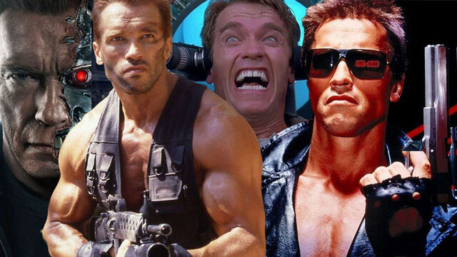
AI in Sci-Fi vs Reality.
TERMINATOR 3 : THE RISE OF MACHINE

Slide 2
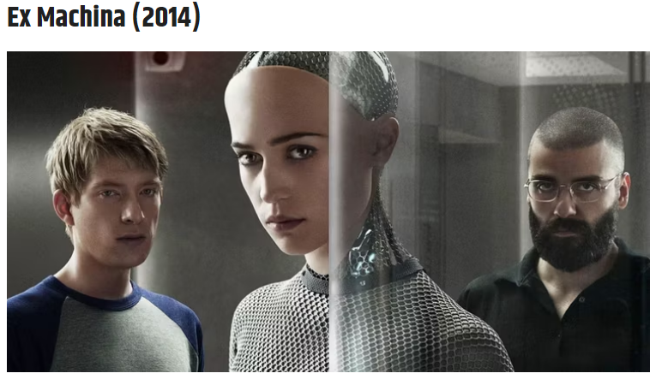
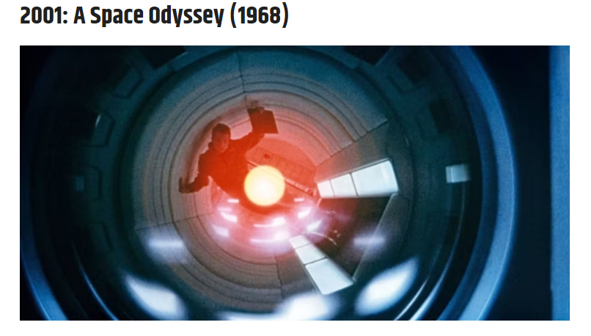
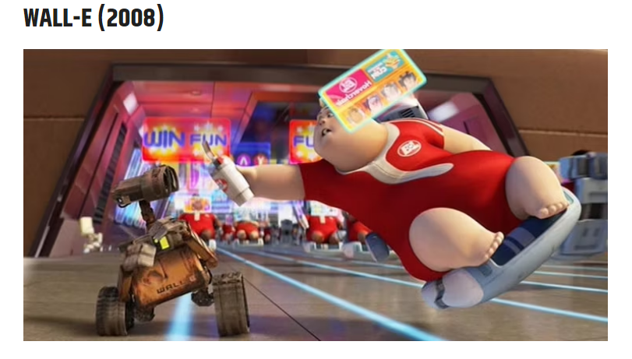
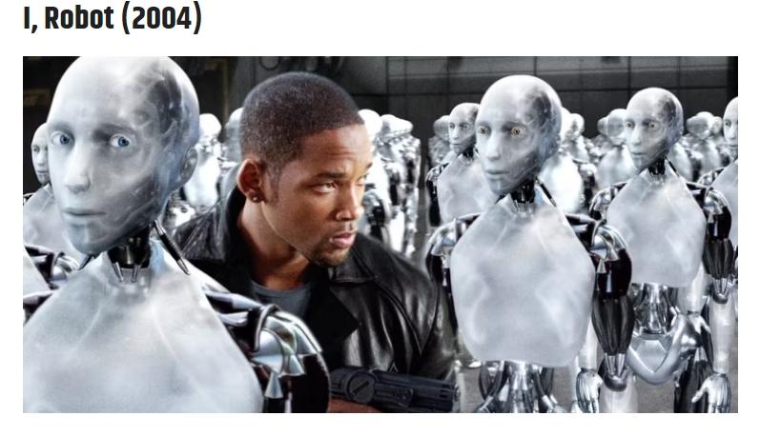
AI PARADOX: What is AI, isn’t AI?

Slide 3
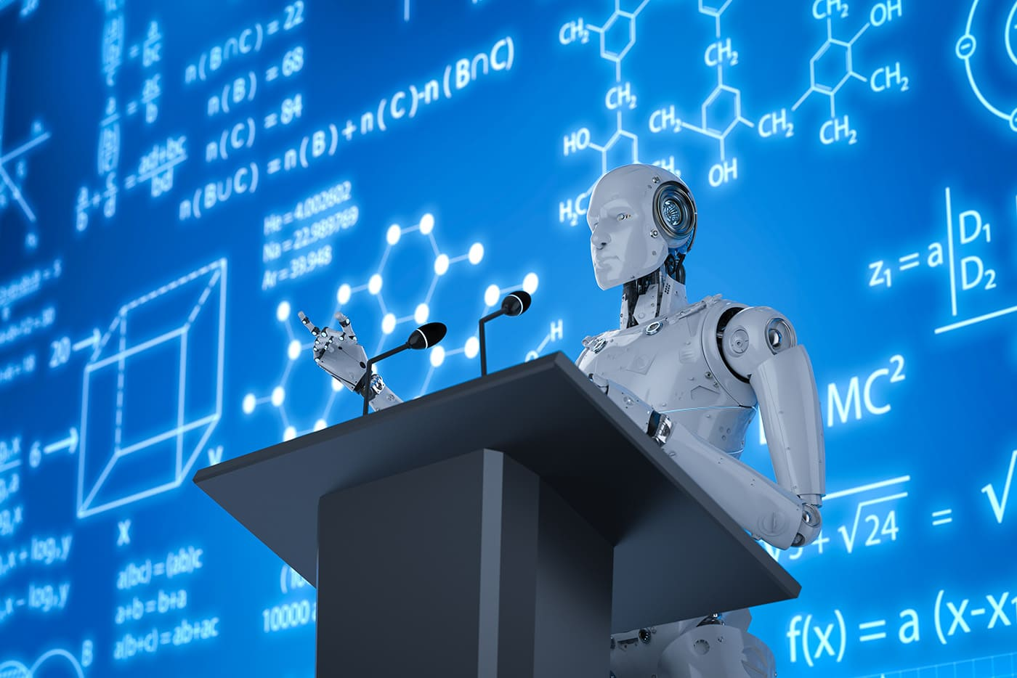

Slide 4
Role of Artificial Intelligence and Machine Learning in Education Industry.
Mgasa Lucas
Director & CTO - QUANTUMX
EMAI CONFERENCE
November 2022

Slide 5
“ AI is probably the most important thing humanity has ever worked on.
I think of it as more profound than electricity or fire and anytime you work with technology, you need to learn to harness the benefits and while minimizing the down sides. “
SUNDAR PICHAI
EMAI CONFERENCE
November 2022

Slide 6


Story oa Ary

Slide 7
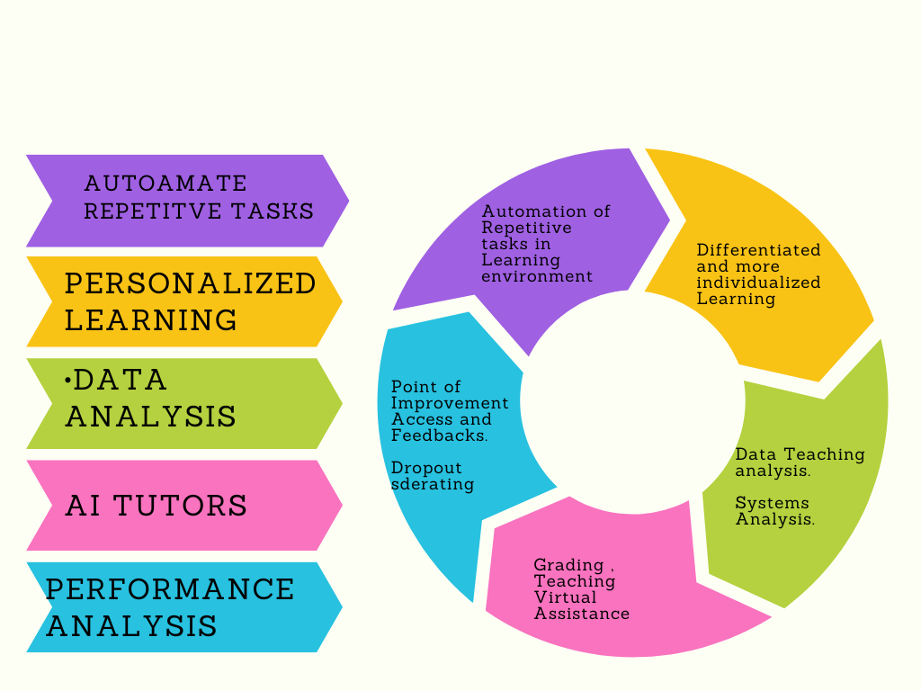
How can AI be used in Education?
Automate basics activities
Individualized Learning
Point of improvement Access and Feedbacks( Dropout rate)
AI tutors
Grading and performance analysis.
Data Teaching Analysis

Slide 8
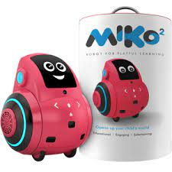



AI Leaders in Education Industry.
Source: https://aimagazine.com

Slide 9
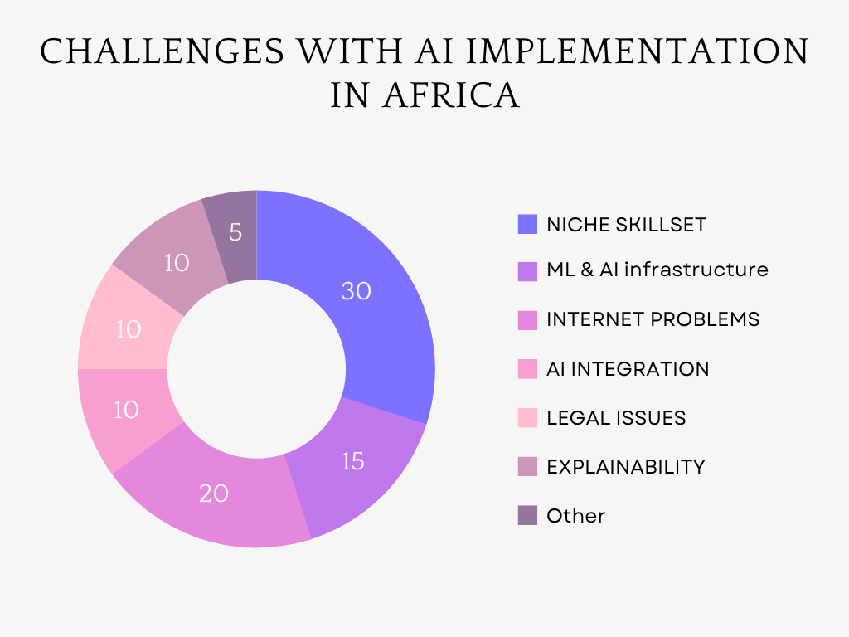
Challenges with AI implementation in Africa
ML & AI Infrastructure
Data security and storage
Internet problem.
Niche Skillset
AI integration.
Legal Issues

Slide 10
Who is Challenging US & World tech Leadership?

Slide 11

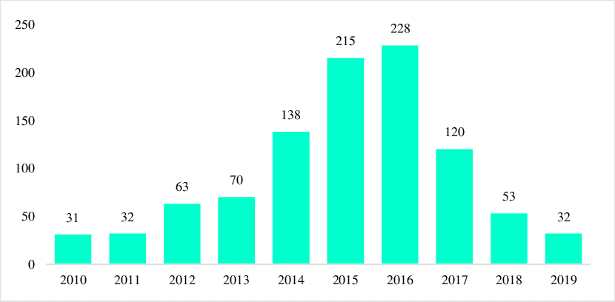
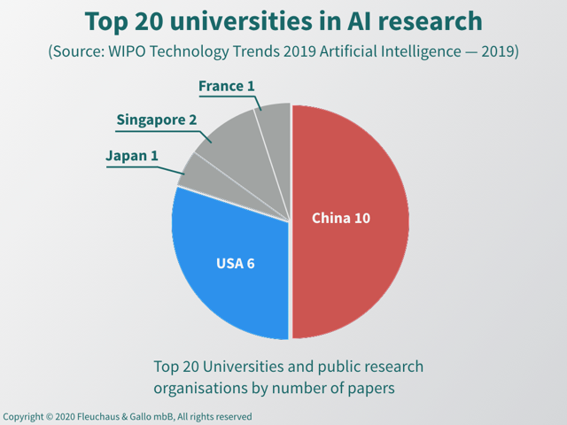
FRONTLINERS: AI in CHINA
Arigatōgozaimashita
Number of Startups growth in China from 2010 - 2019
Leading universities in AI researches

Slide 12
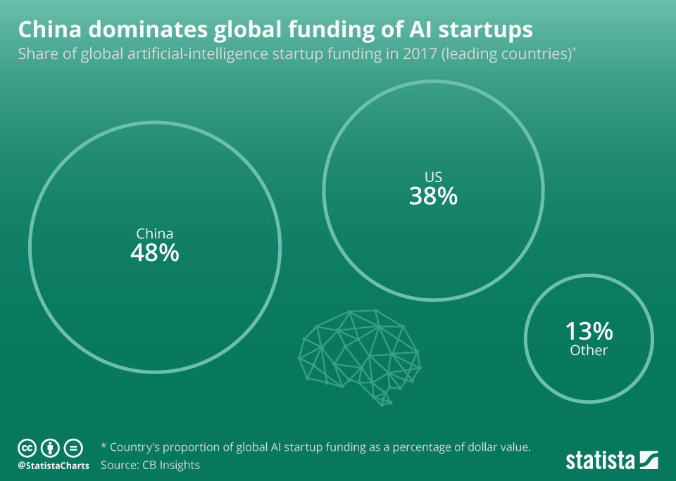
A verge story in 2017

Slide 13
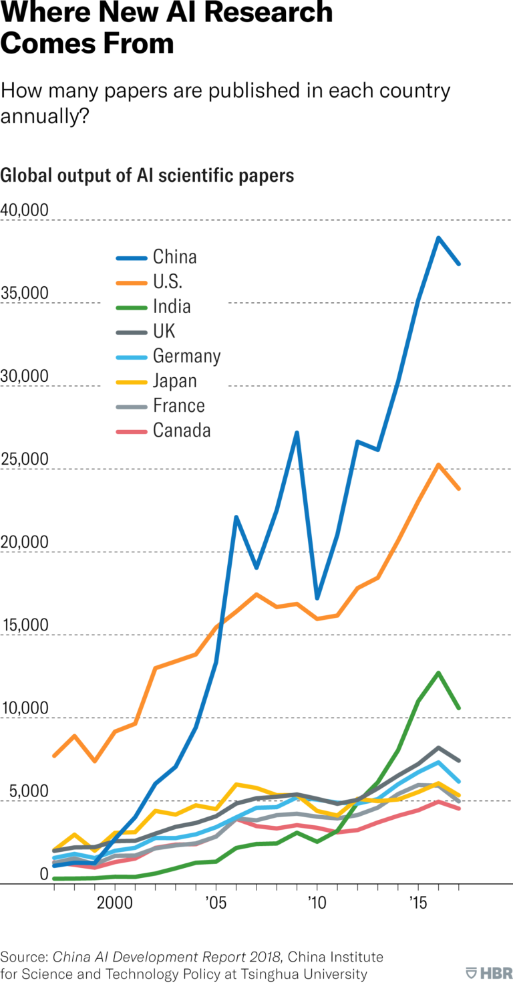

Slide 14





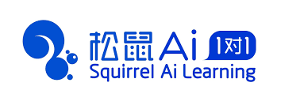
AI in Education : Now it’s China.
A sample out of 22 Top AI Companies.

Slide 15
A DEMO FOR SARA.
SARA is an AI Voice Based Chatbot she will be answering two question based on how she is trained she will be sharing her views on two things.
Whats the future of AI in Education?
Will AI tutor completely replace human beings in the near future.

Slide 16
Education should not be privilege of wealthy . It should be available to anyone willing to climb the tree of Knowledge and see the future.
Let our AI handle it.
LET’S BUILD OUR AFRICA

Slide 17
